Slide 1
PSY 652 Midterm Review
Fall 2017

Slide 2
Example: MHDATA
This data is from a study in Alachua County, FL that examines mental health and several predictor variables.
DV: Mental Impairment (MI): includes many dimensions of psychiatric symptoms (e.g., depression, anxiety). Higher scores indicate more impairment.
IV: Life Events Score (LIFEEV): composite measure of the number and severity of major life events (e.g. death, affair, new job) experienced during the past 3 years. Higher scores indicate more severe life events.
IV: Socioeconomic Status (SES): composite index of occupation, income, and education. Higher scores indicate more affluent status.

Slide 3
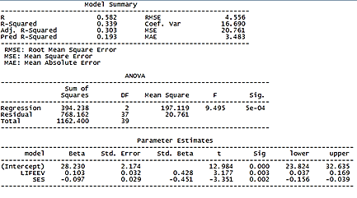
Output

Slide 4
Output

Slide 5
Model Summary

Slide 6
Model Summary
R
Correlation between the outcome and the linear combination of predictors. (in SLR it is Pearson's R and is equal to std. beta)
R²
the proportion of total variability in the outcome that is accounted for by the regression model.
R² = SS_{regression} / SS_{total}
Adj. R²
An indication of how much variance the model explains, but rewards parsimony. It is NOT a proportion like R².
Pred. R²
Indicates how well a regression model predicts responses for new observations

Slide 7
ANOVA (analysis of variance)

Slide 8
ANOVA- Sums of squares
SS_{total}
Represents the total variability present in Y
SS_{total} = SS_{regression} + SS_{residual}
SS_{regression}
Represents the variability in Y that can be accounted for by the model
SS_{regression} = SS_{total} – SS_{residual}
SS_{residual}
Represents the variability in Y that is attributed to error
SS_{residual} = SS_{total} – SS_{regression}
Remember, R² = SS_{regression} / SS_{total}

Slide 9
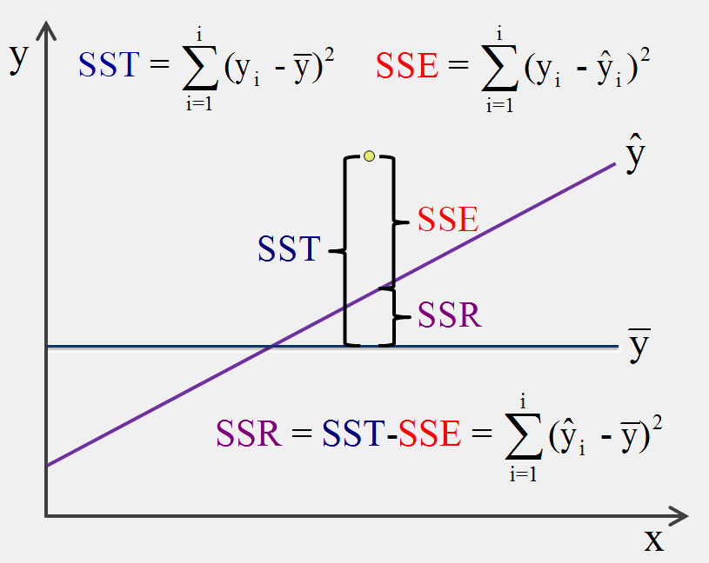

Slide 10
ANOVA

Slide 11
ANOVA- Mean squares & df
MSregression
Represents the amount of variability in Y explained by the model adjusted for degrees of freedom.
MSregression = SSregression / df
MSresidual
Represents the amount of variability in Y attributed to error, adjusted for degrees of freedom.
Msresidual = SSresidual / df
Degrees of Freedom
Regression: k (number of predictors)
Residual: n – k – 1
Total: n – 1

Slide 12
ANOVA

Slide 13
ANOVA- F statistic
F statistic
The ratio of explained variance to unexplained variance
F = MS_{regression} / Ms_{residual}
If F is significant, then we reject the null hypothesis that all the regression coefficients are equal to zero.
F is an omnibus test. It doesn’t tell us anything about individual predictors, only the model as a whole.
Sig.
p-value for F

Slide 14
ANOVA

Slide 15
Parameter Estimates

Slide 16
Beta
Intercept
Y-intercept of the linear model. The value of Y when all predictors equal zero.
Predictors: regression coefficients
SLR: The expected change in Y for every one unit increase in x.
MLR: The expected change in Y for every one unit increase in x holding all other predictors constant.
Beta is used in the calculation of t* and p

Slide 17
Beta- interpretation
The estimate for the slope of LIFEEV indicates that, while holding SES constant, every one unit increase in LIFEEV results in a 0.103 unit increase in predicted MI score. The p value is less than alpha; therefore this estimate is statistically significant. In other words, there is less than a 5% chance that the estimated slope (or a more extreme slope) would be obtained if the null hypothesis was true. Therefore, we reject the null hypothesis that the slope is equal to zero.

Slide 18
Parameter Estimates

Slide 19
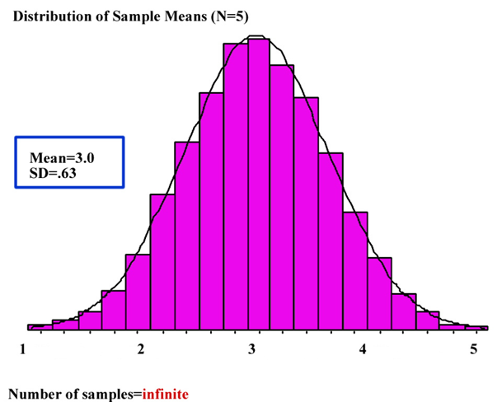
Std. Error
Sampling Distribution
Fit the same model in a large number of random samples and plot a histogram for the estimates for beta.
Standard Error
The standard deviation of the frequency distribution for beta
Standard error is used in the calculation of t* and p

Slide 20
Parameter Estimates

Slide 21
Std. Beta
Estimates for Beta with all variables express as Z-scores.
MLR: the expected change in standard deviations for Y, given a one standard deviation increase in X while holding all other predictors constant.
SLR: the expected change in standard deviations for Y, given a one standard deviation increase in X
For SLR, Std. Beta = Pearson’s R
|Std. Beta| = R from model summary

Slide 22
T statistic
This is t*, the test statistic for each parameter estimate
A ratio of systematic variance to unsystematic variance
t* = beta / standard error
t* is compared to t_{crit}
If t* is larger, then we reject the null hypothesis that beta = 0
t_{crit} represents the largest t value we would expect to find 95% of the time if the null hypothesis were true. t_{crit} changes depending on the degrees of freedom.
Sig.
P-value: the probability of obtaining the observed t* (or one that is more extreme) if the null hypothesis were true.

Slide 23
Parameter Estimates

Slide 24
Confidence Intervals
Confidence Intervals
An interval that contains 95% of the sampling distribution of the parameter estimate.
If we estimate the same model in many random samples, the parameter estimate in 95% of the models will fall within the confidence interval
The confidence interval gives an indication of the range of feasible values for the parameter estimate.

Slide 25
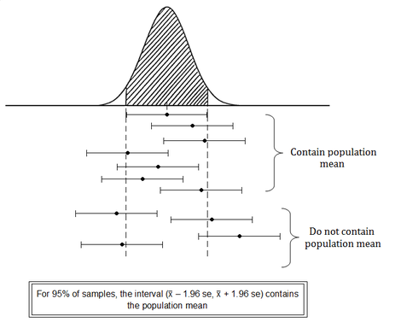


Slide 26
Confidence Intervals
CI = Beta +/- t_{crit} * s.e.
Standard error describes the sampling distribution.
Calculating a confidence interval centers the sampling distribution at the estimate for beta, then finds the range of values that contain 95% of that distribution
If the C.I. does not contain zero, then the parameter estimate is statistically significant.

Slide 28
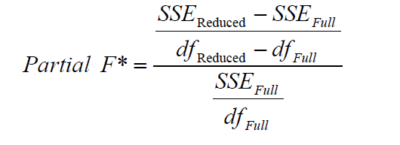
Partial F Test
Adding additional predictors to a regression model will always reduce SS_{residual} (i.e. will explain more variance)
However, we must perform a test to determine if the improvement is statistically significant.
The Partial F Test compares two nested models and tests the null hypothesis that the reduction in SS_{residual} resulting from the additional predictors in the more complex model is equal to zero.

Slide 29
Partial F Test example
For our research question, we are interested in predicting job satisfaction, which leads to a variety of positive work-related outcomes (such as higher commitment to an organization, lower counter-productive behaviors, and lower turnover). With so much data available, we need to decide which variables make sense to include.

Slide 30
Variables (blue = control, purple = predictors of interest
HLPEQUIP: I receive enough help and equipment to get the job done
HAVEINFO: I have enough information to get the job done
CONDEMND: I am free from the conflicting demands that other people make of me
OPDEVEL: I have an opportunity to develop my own special abilities
FRINGEOK: My fringe benefits are good
SUPHELP: My supervisor is helpful in getting the job done
COWRKHLP: The people I work with can be relied on when I need help

Slide 31
Building the Model
We want to control for job constraints: HLPEQUIP, HAVEINFO and CONDEMND
THEN, look at the effects of positive job characteristics:
Development opportunities, Fringe benefits, Supervisor and Coworker support

Slide 32
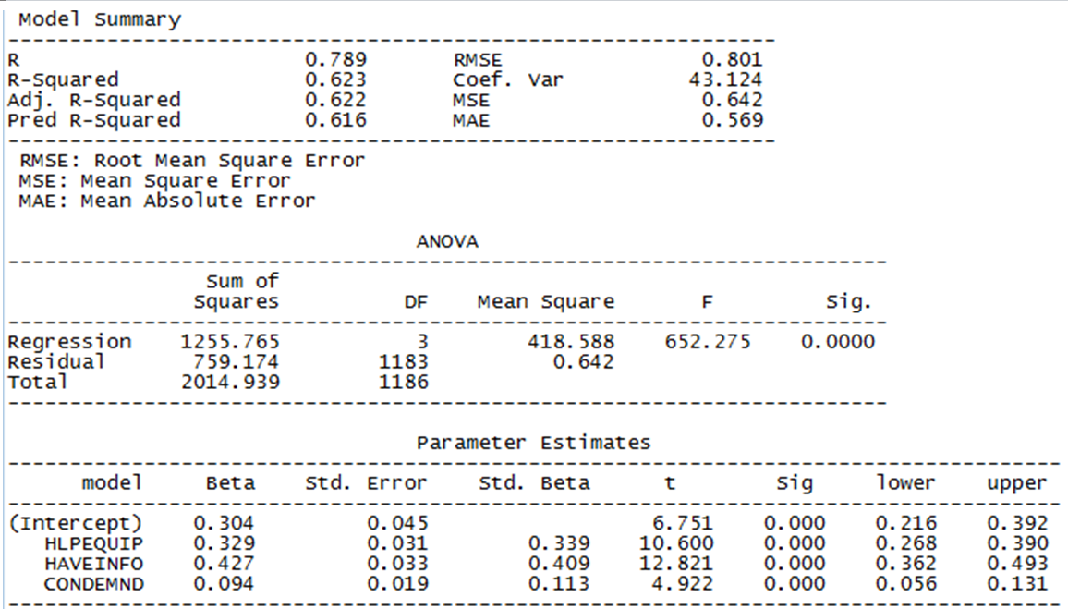
Reduced model

Slide 33
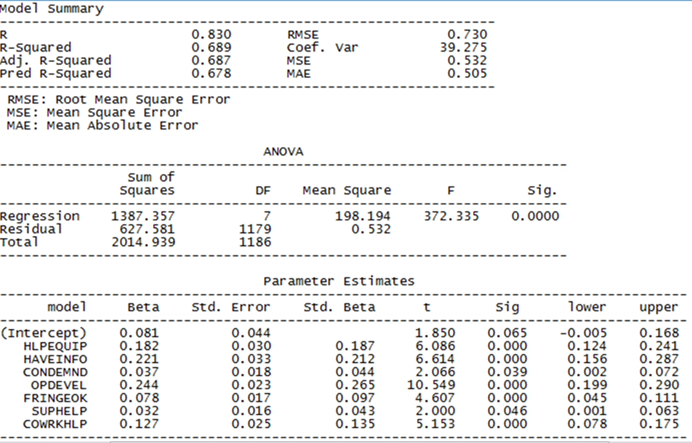
Full Model

Slide 34
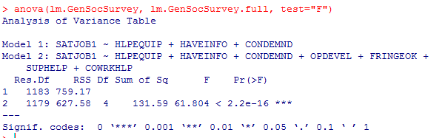
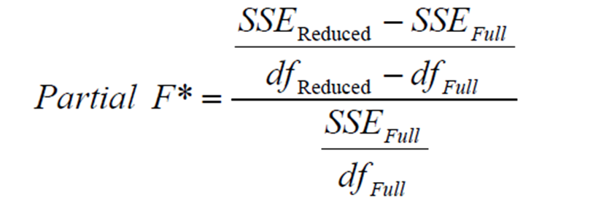
Partial F Test

Slide 35
Interpretation
The partial F test was statistically significant, indicating that the reduced model has significantly worse fit than the full model. We can reject the null hypothesis that the reduction in SS_{residual} resulting from the additional predictors is equal to zero.
If the F value was non-significant, we would not have been justified in adding the other variables because we want the simplest model that explains the most amount of variance.

Slide 36

Semi-Partial and Partial Correlations
Simple correlation:
The relationship
Between X and Y

Slide 37
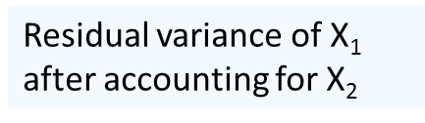
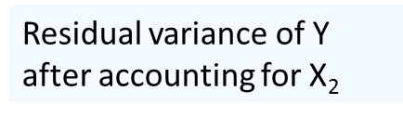
Partial Correlations
Variance explained in Y
after controlling for other predictors

Slide 38
Semi-Partial Correlations
The proportion of the total variance of Y explained by X1, above and beyond other variables.

Slide 39
Semi-Partial Correlation
If you have a reduced model and a full model with just one additional predictor
Squared Semi-partial correlation is equal to:
R²(full model) – R²(reduced model)
OR
{SS_{regression}(full model) – SS_{regression}(reduced model)}
/ SS_{total}(full model)

